Slide 1
HW #6 Feedback/Rubric Score ____/20
Data: _____/5
Appropriate data sources
Discussion of data issues
Analytics: _____/5
Appropriate techniques used
Depth/complexity of analysis
Joins are correct
Good variety of appropriate visualizations
Story: _____/5
Clear thesis/problem statement
Included analytic tell the story
Audience leaves convinced
Professionalism: _____/5
Professional slides
Instructions followed
Submitted on time
A Packaged workbook (.twbx file)

Slide 2
Homework #6
Gage Gutmann
Using a Full Outer Join on Teams Using Player Data and Team Probability Data

Slide 3
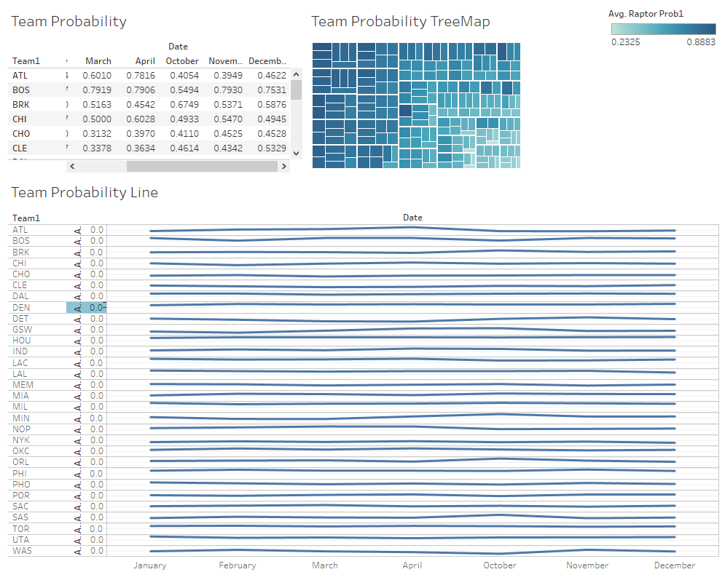
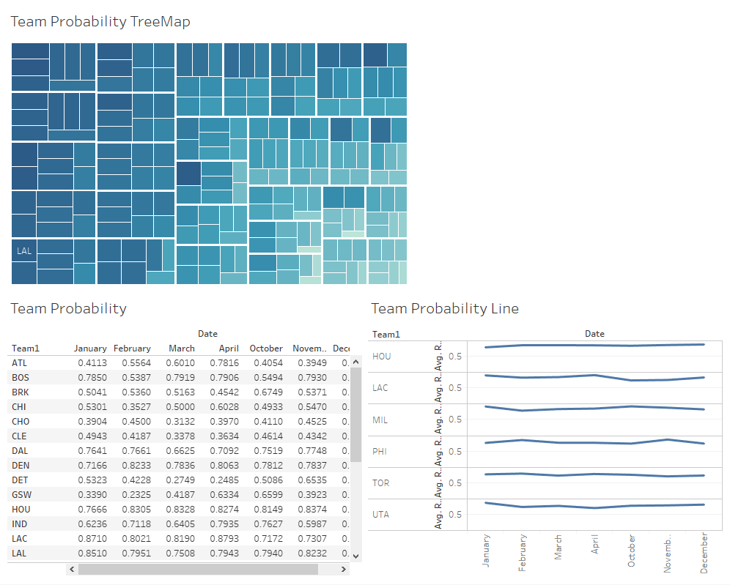

Slide 4
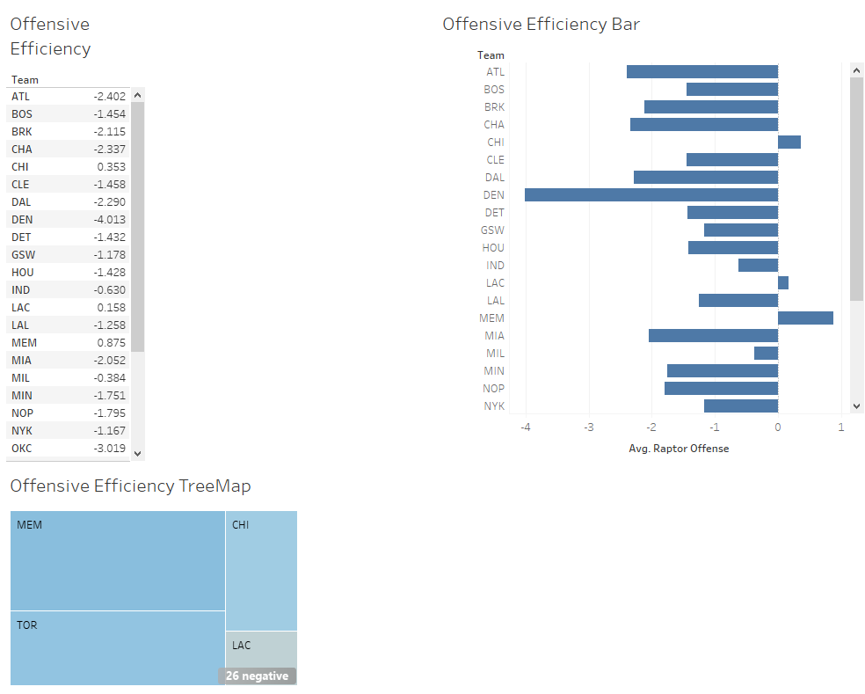
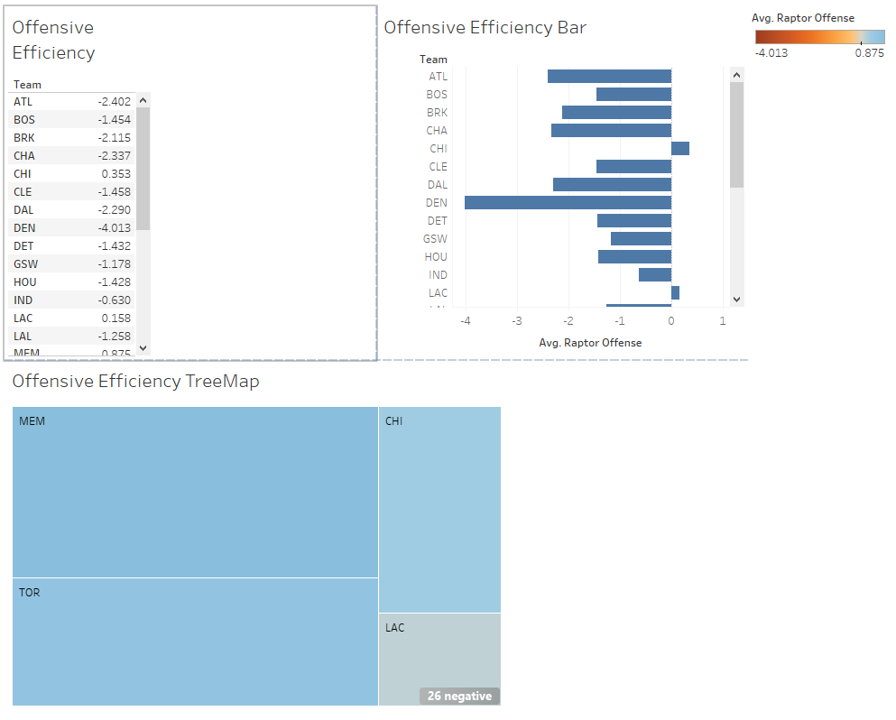

Slide 5
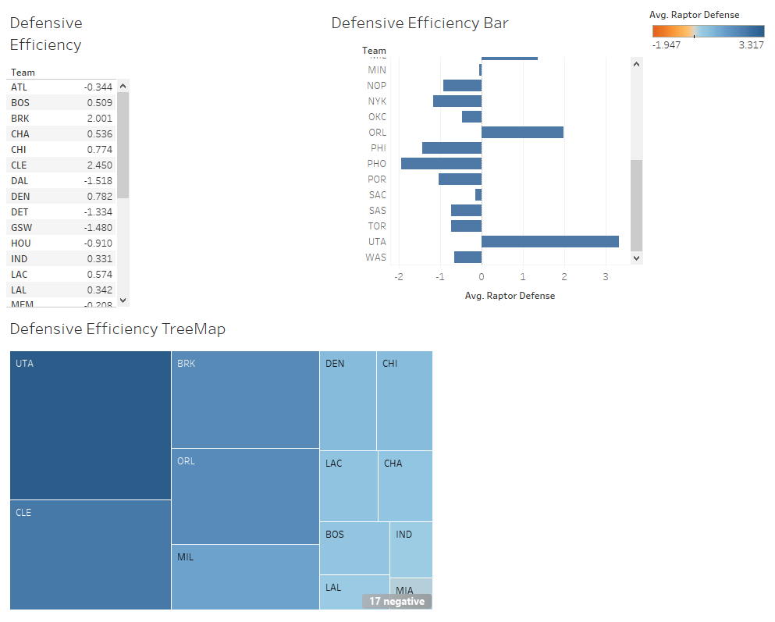
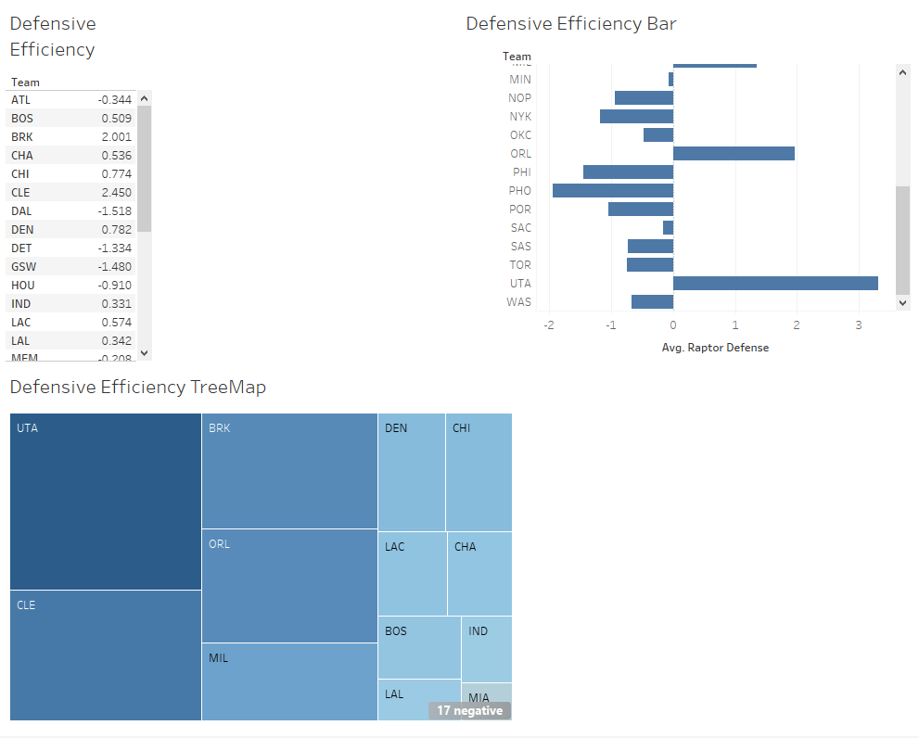

Slide 6
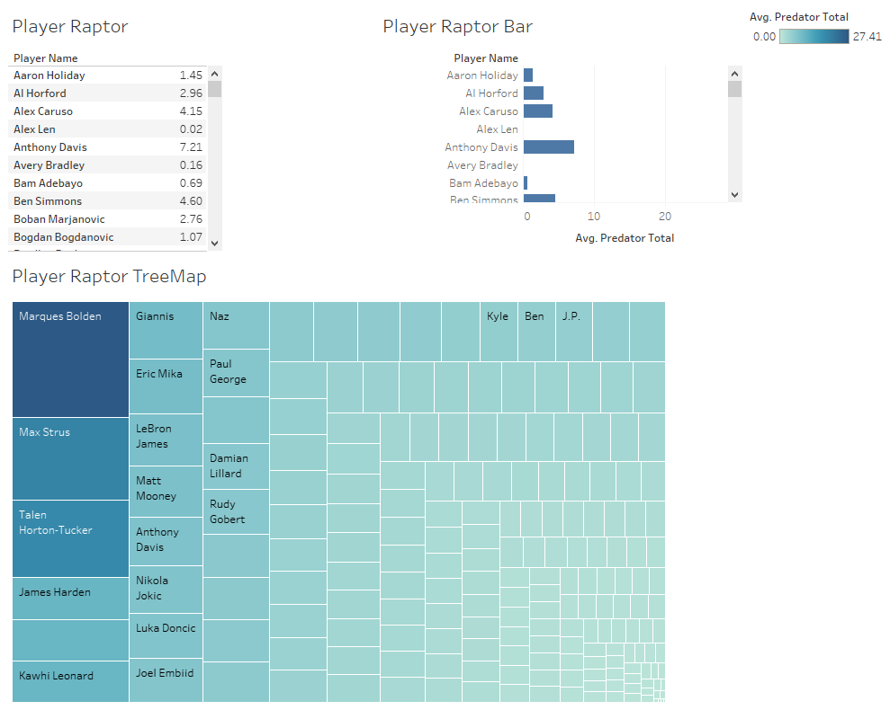

Slide 7
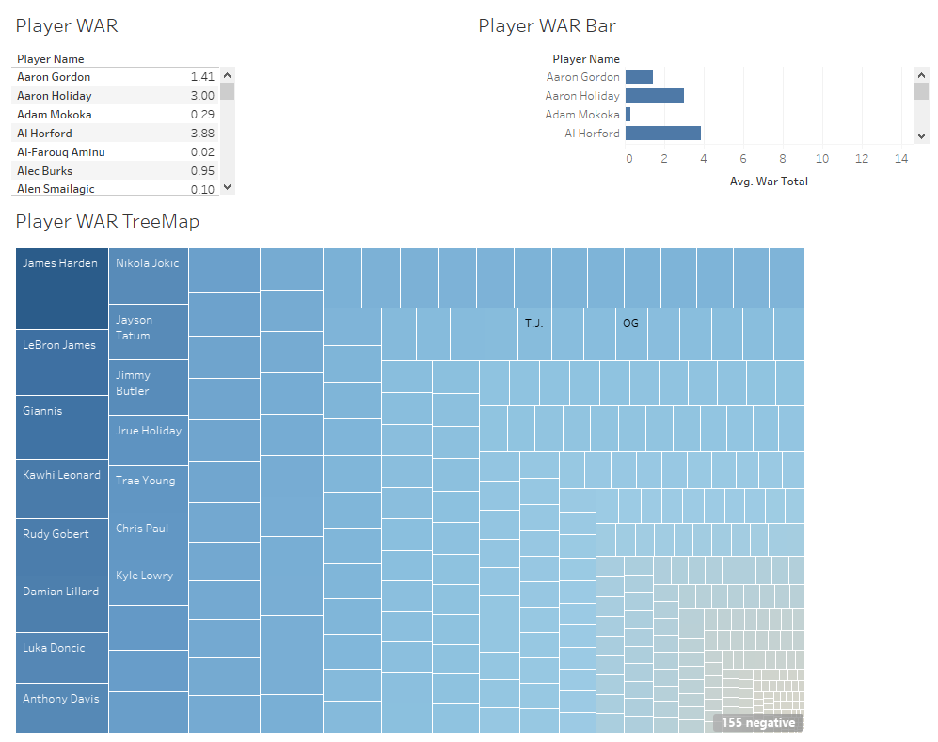

Slide 8
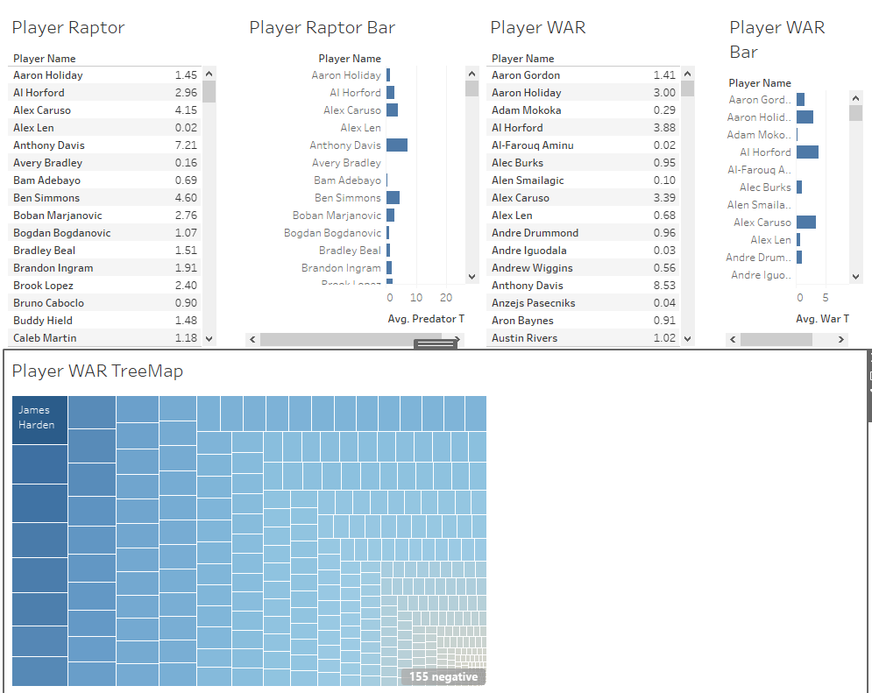

Slide 9
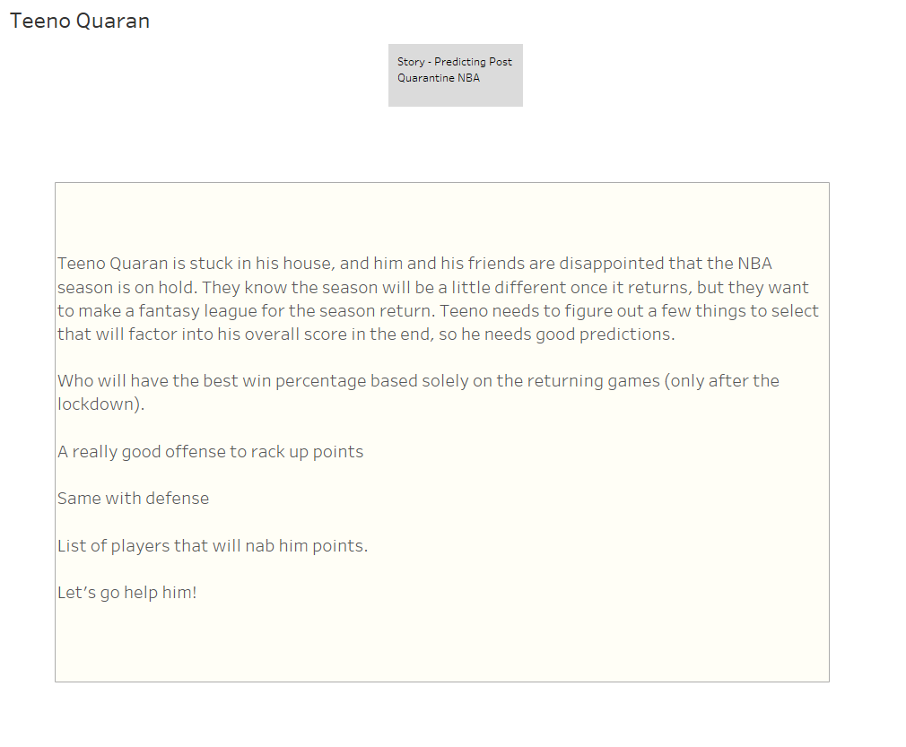

Slide 10
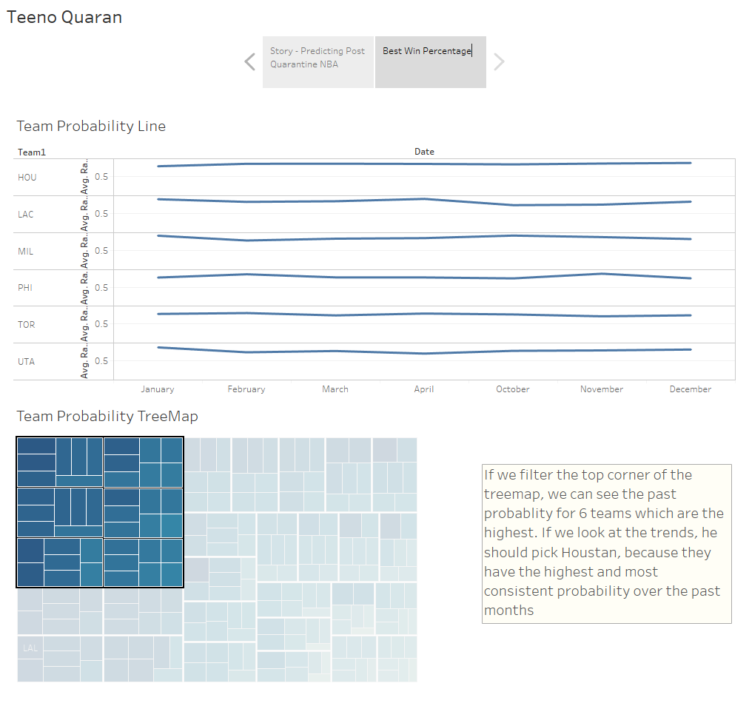

Slide 11
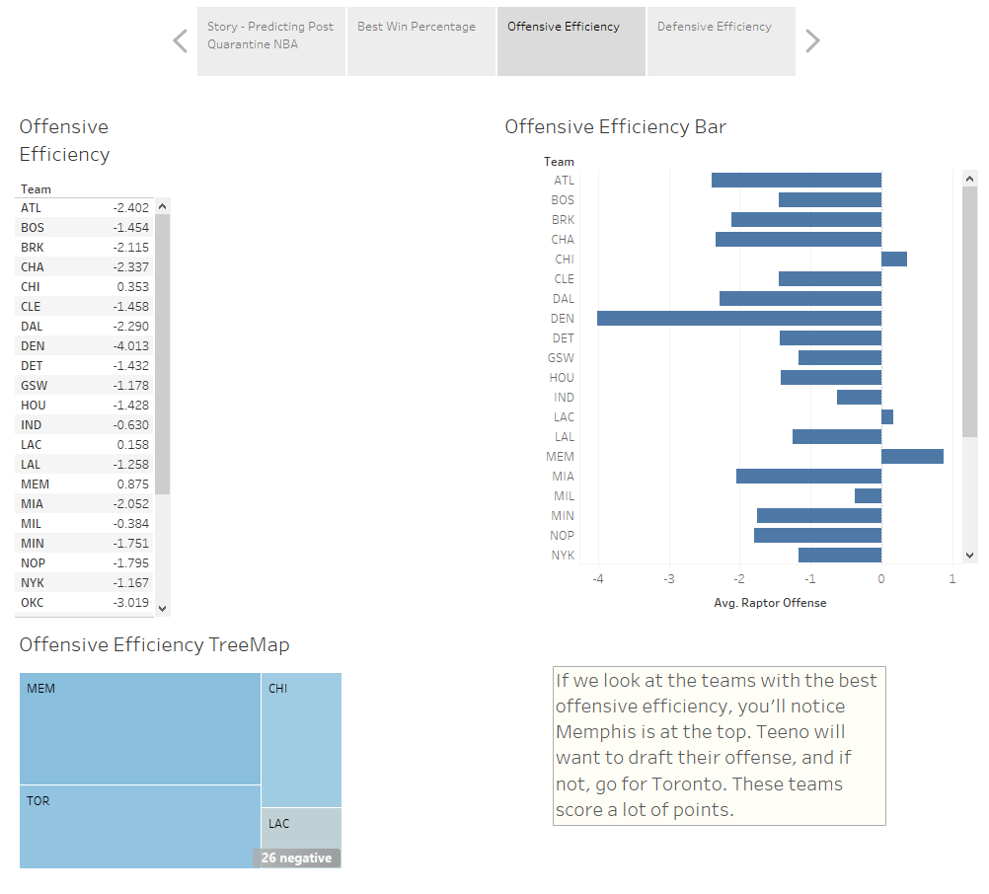
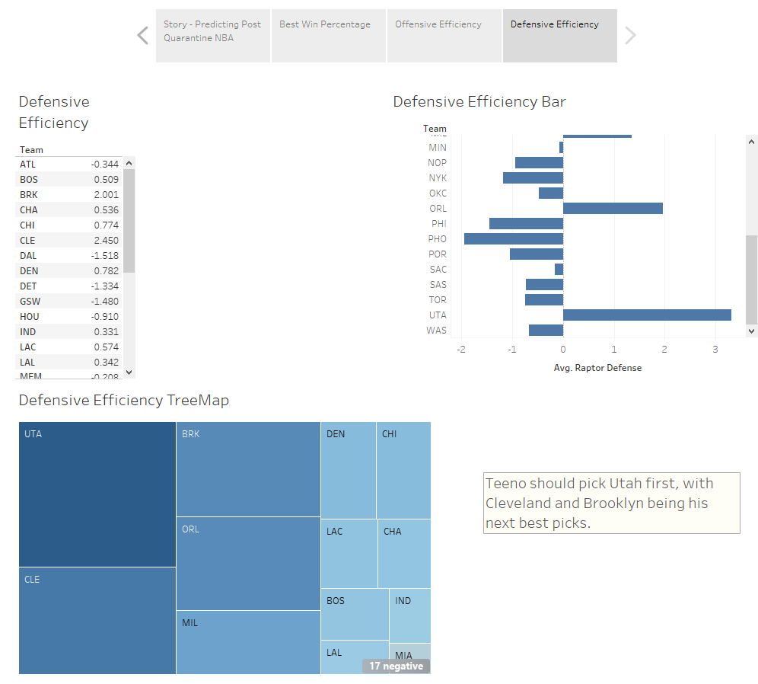

Slide 12
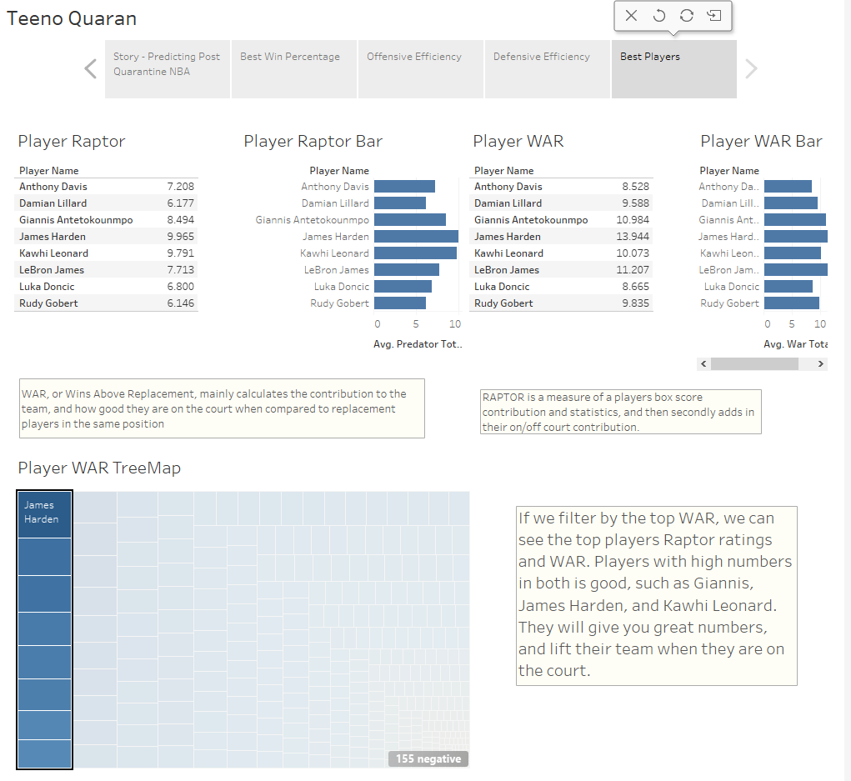

Slide 13
